Slide 1
COMPARISON OF THE PHYSICAL AND BIOMOTOR CHARACTERISTICS BETWEEN JUNIOR TURKISH MALE AND FEMALE ICE HOCKEY PLAYERS
Recep GÜRSOY* Eser AĞGÖN** Robert STEPHENS*** M. Akif ZİYAGİL****
*The Department of Physical Education and Sport, Atatürk University, Erzurum, TURKEY
** The Department of Physical Education and Sport, Erzincan University, TURKEY
*** The Department of Physiology and Cell Biology, College of Medicine, The Ohio State University, USA
**** The Department of Physical Education and Sport, Amasya University, TURKEY

Slide 2
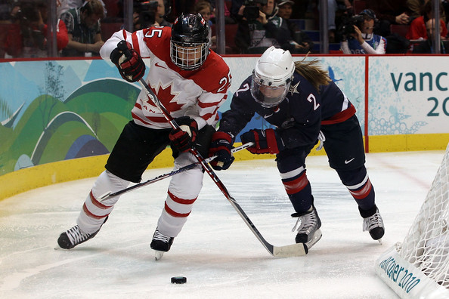
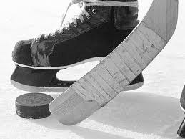
Introduction
Although female and male have played hockey for many years, a paucity of research data exist regarding the differential characteristics of male and female hockey players ¹.
Ice hockey has been depicted as a game played with hockey sticks, skates and pucks ^{2,3}.
1. Sapega A A, 1982
2. Sim FH, Chao EY. 1978
3. McFaull S. 2001

Slide 3
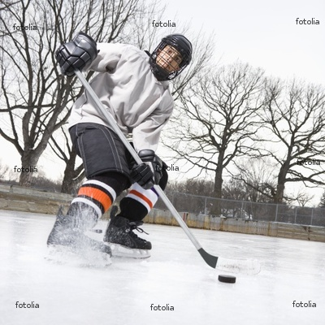
Skating in ice hockey is a complex motor skill ⁴ and it is uniquely stressful the high level of coordination required, the repeated demands made on the muscles with little rest and the astounding requirement that it is played while balancing on skate blades are all factors leading to rapid fatigue⁵. In addition, ice hockey presents complex physical, physiological, and biomechanical challenges for players⁶⁻⁷ Many experts believe the most important skill in ice hockey is skating ⁵
4. Green H. 2003
5. Hansen H, Reed A. 1979
6. Bracko MR, at all. 1998
7. Marino GW. 1979

Slide 4
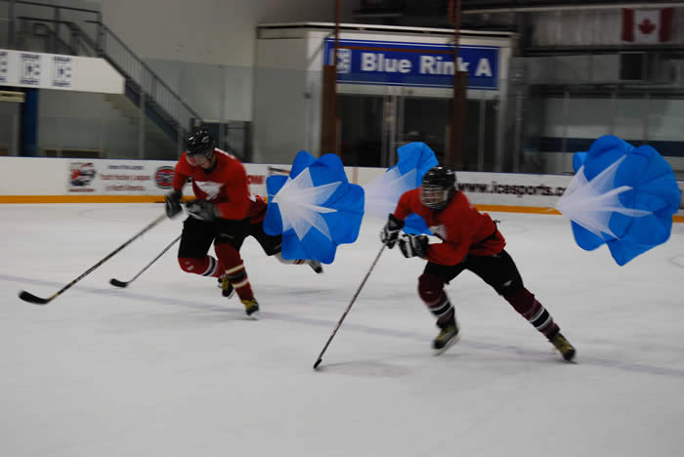
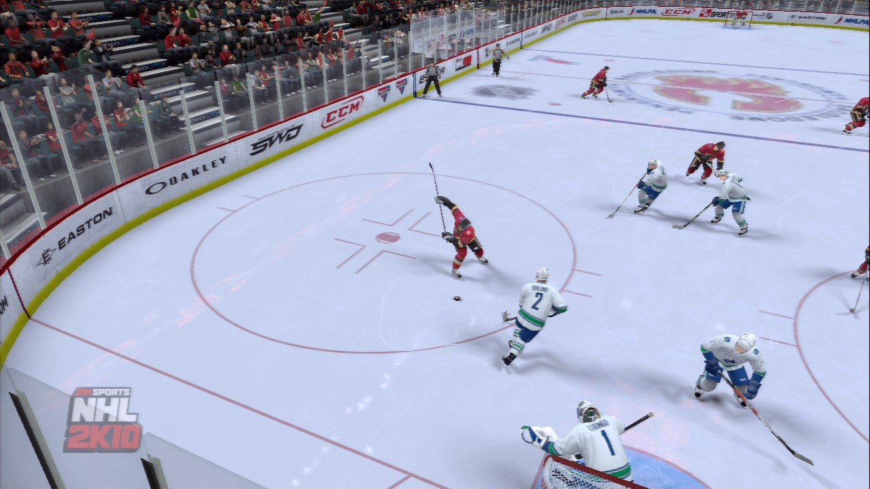
Vescovi et al. examined the physical and physiological characteristics of elite male ice hokey players with a mean age of 18.0 ± 0.6 years according to their playing positions. They concluded that there were significant differences in the view of anthropometric measurements, upper body strength, and anaerobic power among positions for elite-level ice hockey players ⁸.
8. Vescovi, J.D. at all. 2006

Slide 5
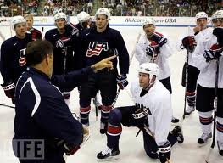
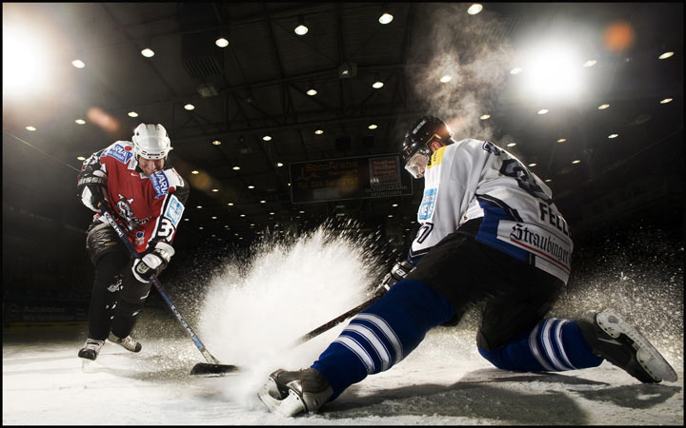
Understanding the physical performance characteristics of male and female hockey players can help identify weakness in conditioning, improve performance, establish baseline performance data and develop scientifically based training protocols.
The game-performance skating characteristic of ice hockey players is important for the team practitioners and coaches, because there are implications for on- and off-ice fitness training.
Although physical and physiological profiles of ice hockey players were studied by several researchers, there is no study which has specifically addressed the characteristics of Turkish ice hockey players’ physical and biomotor characteristics in the literature.
Therefore this study aims to measure and compare the physical and biomotor characteristics of male and female junior Turkish ice hockey players aged 17 to 25 years.

Slide 6
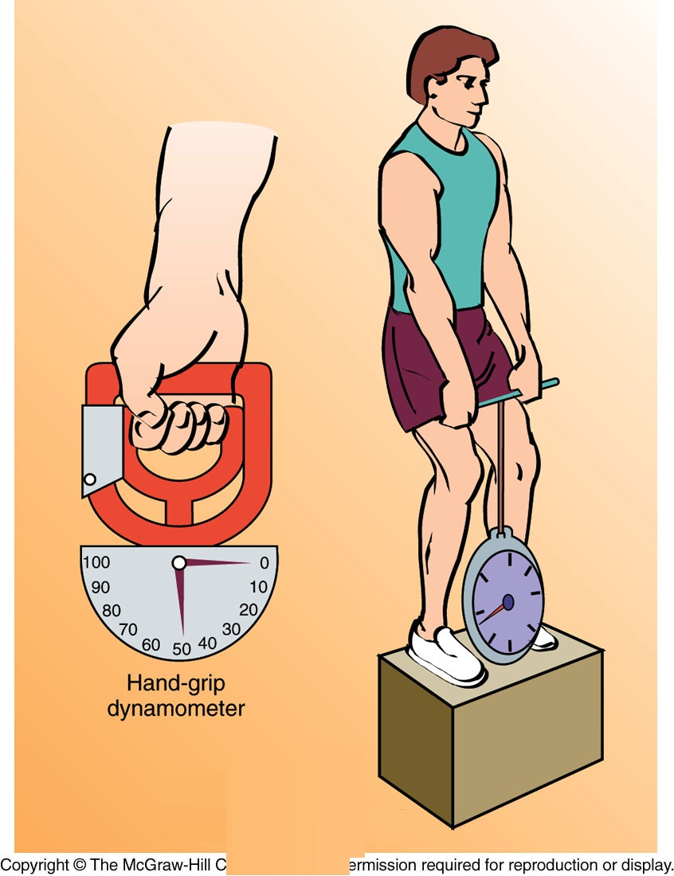
Materials and methods
37 healthy subjects comprising 17 male and 20 female ice hockey players from Erzurum region have voluntarily participated in this study.
Height and body weight with short and t shirt out were measured in the morning before breakfast. Height in centimeters and body weight in kilograms were recorded.
Takei Kiki Kogyo Dynamometers were used to measure muscle strength between 1 and 100 kg. For warm up, participants exercised 15 minutes prior to these measurements.
A handgrip dynamometer was used to measure the isometric hand strength, and a leg dynamometer was used to measure the isometric leg and back strength.
Measurements were repeated three times with two minutes intervals and the highest measurement was used for analysis.

Slide 7
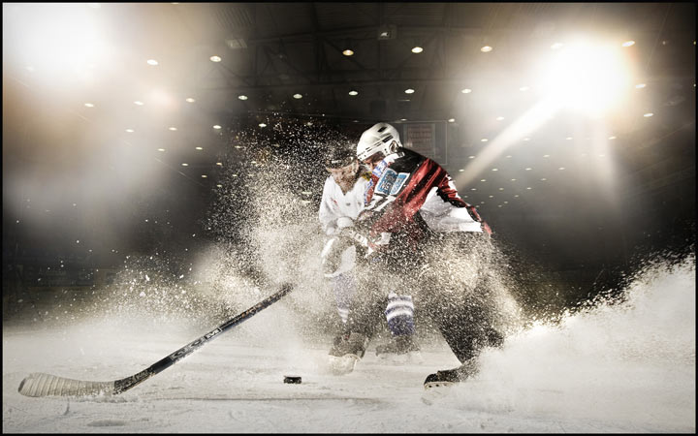
Reaction time was assessed by a soft ware package of random stimulus presentation and response recording. Vertical jump was measured using the protocol of Baumgartner and Jackson with the average of the highest two of three jumps being recorded, anaerobic power was assessed using Sargent JumpTest ⁹.
The hamstring and low back flexibility was determined by the sit-and-reach test. The athlete placed both feet (without shoes) flat against the Flex meter.
The athlete reached as far forward as possible in a controlled manner while keeping the knees straight and palms facing down. The farthest distance reached was recorded to the nearest centimeter.
9. Baumgartner, T., A.S. Jackson. 1987

Slide 8
Results
T-test analysis independently determined differences between the physical characteristics and motor activity of male and female ice hockey players. The data testing are presented in Table 1.

Slide 9
Table 1: Comparison of the physical and biomotor characteristics of male and female ice hockey players
VARİABLE MALE (N=17) FEMALE (N=20)
Age (years) 18.71±1.57 20.40±1.99 Training experience (years) 1.82±0.81 1.20±0.56 Weight (kg) 66.76±11.28** 53.40±4.31 Height (cm) 173. 12±7.44* 164. 60±6.24 Isometric Leg Strength (kg) 71.76±35.20** 29.67±19.29 Isometric Back Strength (kg) 70.71±28.04 ** 25.40±13.69 Right Handgrip Strength (kg) 43.12±6.60 ** 28.73±4.74 Left Handgrip Strength (kg) 43.47±7.05 ** 26.33±4.59 Sit-and-Reach (cm) 8.41±5.40 16.67±5.30** Vertical Jump (cm) 49.76±8.37 41.73±7.23 Anaerobic Power (kg/m/s) 104. 25±21.20** 75.97±7.50 Left Hand Reaction Time (1/1000 s) 317. 65±39.99 314. 80±31.97 Right Hand Reaction Time (1/1000 s) 328. 88±32.66 325. 47±31.36
Values are means and ± is standard deviation of the means.
* Significant difference at p < 0.05 level.
** Significant difference at p < 0.01 level.
There was no difference between male and female ice hockey players in the mean age, training experience, left and right hand reaction time. Though the males had higher vertical jump scores than females, but difference was not significant between two groups. Male players had significantly higher mean height value than females (p < 0.05). The males had also significantly higher mean values than females in the following variables; body weight, isometric leg and back strength, right and left handgrip strength, and anaerobic power (p < 0.01). However, female players had significantly higher scores than males in sit-and-reach test (p < 0.01). The male players were the best in all tests except sit and reach test.

Slide 10
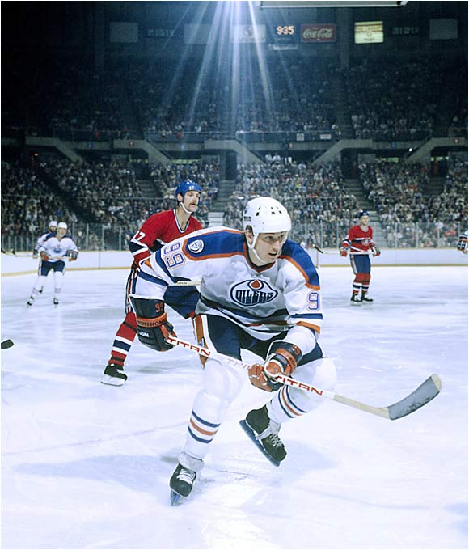
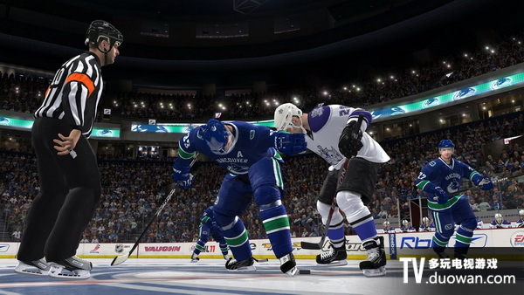
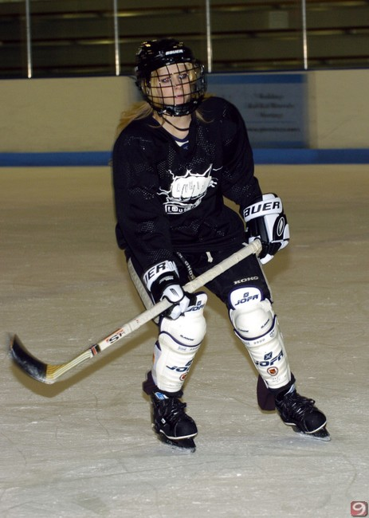
Discussion
This study indicates that there were important structural and functional differences between male and female ice hockey players. Males were heavier, taller, and powerful than females. Females were more flexible than males. There were no significant difference between male and female in the mean values of left hand, right hand, reaction time and vertical jump scores.

Slide 11
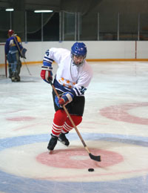
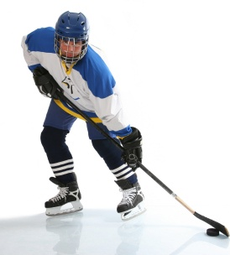
Michela et al. found that 12-13 years old male ice hokey players had higher mean values of body weight. Also 14-15 years old males were more powerful than females¹⁰. These results were parallel with findings of our study. But our flexibility results were not consistent with findings his because there was no difference in the flexibility of the players in study of Bracko ¹¹.
10. Micheal R. Bracko and Gilbert W. Fellingham. 2001
11. Bracko, M.R. 2001

Slide 12
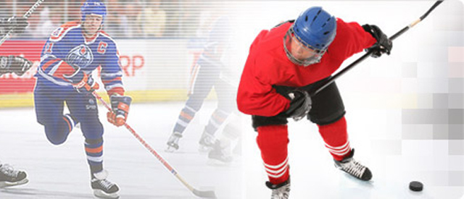
In the study of Michael et al., all groups had similar acceleration performance ¹⁰. Similarly, Bracko found insignificant difference in the accelerating ability between elite and non- elite female ice hockey players ¹¹. Bracko et al. also found that non-age matched male high school players were similar in acceleration. It appears that the accelerating ability did not differentiated significantly for younger and older elite and non-elite females, and young non-elite male hockey players. But male ice hockey players were faster than the females on the speed test ¹².
10. W. Fellingham. 2001
11. Bracko, M.R. 2001
12. Micheal R. Bracko and G. W. Fellingham, and R.D. Lyons. 1996

Slide 13
Anaerobic fitness is an important performance variable for hockey players, and information about on-ice fitness can be an important criteria for a coach to understand a player's ability ¹³.
Bar-Or suggest the accuracy of ‘‘field tests’’ maybe questioned because of the skill level required to perform well ¹⁴.
Nevertheless, skating ability, and testing skating ability are important aspects of hockey performance ¹⁵.
Bracko found that 10-11, 12-13, 14-15 years male ice hockey players have higher anaerobic power than females ¹². Sport scientists are concerned with eliminating the skill factor in exercise testing to produce objective results, whereas coaches are interested in a player’s sport-specific fitness and game -performance skating ability ¹⁶.
13. Montegomerty, D. L. 1998
14. Bar-Or, O. 1987
15. Hansen, H,. and A. Reed. 1979
16. Watson, R. C,. and T.L.C. Sargeant. 1986

Slide 14
As a result, the current findings can be used to identify physical characteristics and biomotor abilities for junior male and female ice hockey players and regular measurement of physical and functional characteristics of athletes is an important method used in comparing athletes from two different teams as well as in evaluating the efficiency of their training programs.

Slide 15
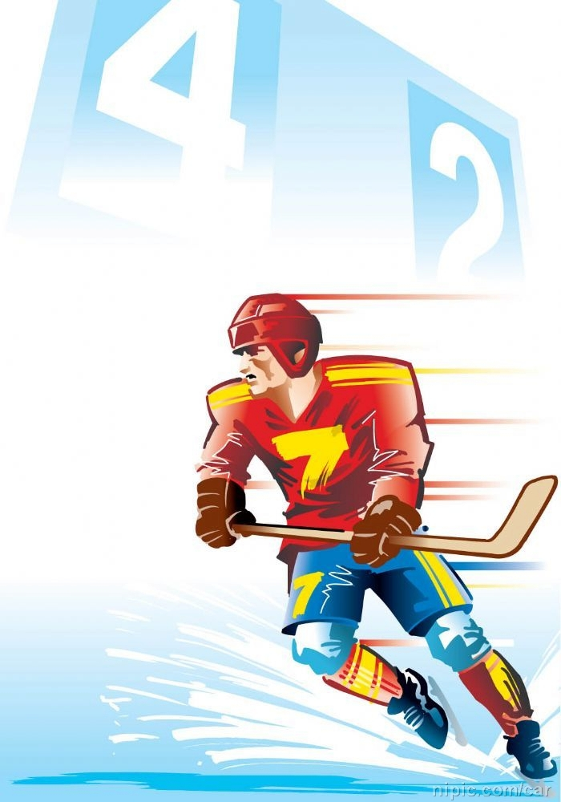
THANK YOU
thank you

