Slide 1
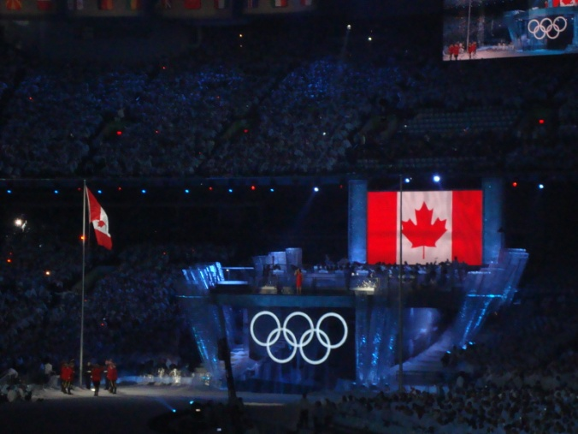
DOPING CONTROL IN A WINTER GAMES AN OLYMPIC PERSPECTIVE

Slide 2
DOPING CONTROL IN A WINTER GAMES AN OLYMPIC PERSPECTIVE
VANOC Anti-Doping Mission:
Deliver a state-of-the-art doping control program at the 2010 Games to ensure all athletes can compete on a level playing field.
Leave a legacy by developing and implementing a leading anti-doping program focusing on pre-games information and awareness programs to promote the values of doping free sport.
Doping-free Games

Slide 3
DOPING CONTROL IN A WINTER GAMES AN OLYMPIC PERSPECTIVE
Test Events: 2009 - Goals
Carryout doping control at all Test Events
Test anti-doping program operations and personnel including blood collection
Ensure all athletes coming to Vancouver realize they will be subject to doping control
Educate and inform athletes and support personnel

Slide 4
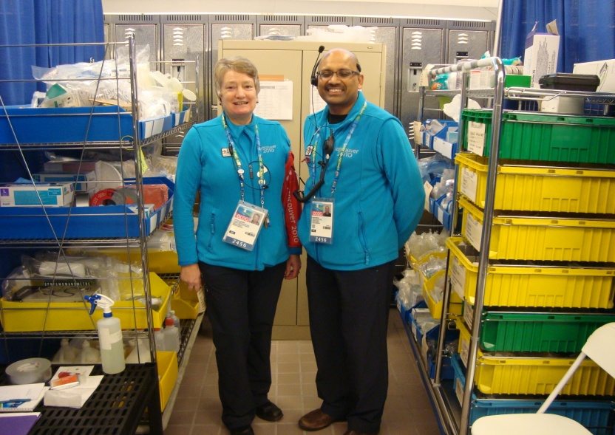
DOPING CONTROL IN A WINTER GAMES AN OLYMPIC PERSPECTIVE
Sample Collection Personnel
103 Doping Control Officers
42 Blood Collection Officers
290 Chaperones
Training prior to the sport event along with evaluations of all personnel during the sport event

Slide 5
DOPING CONTROL IN A WINTER GAMES AN OLYMPIC PERSPECTIVE
INRS Laboratory
All samples (urine and blood) collected were sent to INRS Laboratory for analysis.
Urine samples sent by FedEx for analysis.
Blood samples packaged in Berlinger cooler boxes and sent by World Courier for expedited analysis.

Slide 6
DOPING CONTROL IN A WINTER GAMES AN OLYMPIC PERSPECTIVE
INRS Laboratory
All results sent directly to the International Federation (VANOC acted only as sample collection authority)
Provided laboratory the opportunity to become familiar with VANOC anti-doping operations.

Slide 7
DOPING CONTROL IN A WINTER GAMES AN OLYMPIC PERSPECTIVE
INRS Laboratory
Communication plan was developed between VANOC + INRS to advise of when samples / types would be sent for analysis.
Sample transportation plan mimicked Games in order to determine time readiness

Slide 8
DOPING CONTROL IN A WINTER GAMES AN OLYMPIC PERSPECTIVE
Anti-Doping Program: IOC and IPC Authority
Under the authority and jurisdiction of the IOC and
IPC Anti-Doping Rules
Consistent with the World Anti-Doping Agency
(WADA) Code, and the WADA Prohibited List

Slide 9
DOPING CONTROL IN A WINTER GAMES AN OLYMPIC PERSPECTIVE
“Deliver a state-of-the-art doping control
program at the 2010 Games to ensure all
athletes can compete on a level playing field”

Slide 10
DOPING CONTROL IN A WINTER GAMES AN OLYMPIC PERSPECTIVE
Anti-Doping Program:
2157 tests at the Olympics
444 tests at the Paralympics (both blood and urine )

Slide 11
DOPING CONTROL IN A WINTER GAMES AN OLYMPIC PERSPECTIVE
Anti-Doping Program: Detection and Deterrence
Testing conducted anytime, anywhere from Feb 4-
28 and March 6 – March 21, 2010
Intelligence based, targeted testing – (use of
ADAMS and Athlete Whereabouts Program)
Significant cooperation with WADA and
International Federations

Slide 12
DOPING CONTROL IN A WINTER GAMES AN OLYMPIC PERSPECTIVE
Vancouver 2010 Olympic Games Summary
15 Olympic disciplines: 2157 tests
878 Pre-competition:
(632 urine / 246 blood)
1279 Post-competition:
(1084 urine / 195 blood)

Slide 13
DOPING CONTROL IN A WINTER GAMES AN OLYMPIC PERSPECTIVE
IF Blood Screening Program Summary:
FIS (X-country + Nordic Combined) - 345
IBU (Biathlon) – 31
ISU (Speed Skating + Short Track) – 659
TOTAL IF samples 1035

Slide 14
DOPING CONTROL IN A WINTER GAMES AN OLYMPIC PERSPECTIVE
Doping Control Laboratory
15,000 square feet including wet laboratory, instrumentation room and office areas
Latest analytical techniques for 2010 Prohibited List - IRMS

Slide 15
DOPING CONTROL IN A WINTER GAMES AN OLYMPIC PERSPECTIVE
Doping Control Laboratory: Detection and Deterrence
Urine and blood analysis (EPO, CERA, Insulin, hGH,
Transfusions/HBOCs, Biological Passport)
Most experienced staff and newest equipment of all 35
WADA-accredited laboratories led by Dr. Christiane Ayotte
Operating 24/7 during the Testing Period in 2010

Slide 16
DOPING CONTROL IN A WINTER GAMES AN OLYMPIC PERSPECTIVE
Anti-Doping Program
Cooperation with law enforcement agencies
Integration with security, waste management and
cleaning organizations
Highly experienced international group of Doping
Control Officers, Blood Collection Officers and
Chaperones (600)

Slide 17
DOPING CONTROL IN A WINTER GAMES AN OLYMPIC PERSPECTIVE
“Leave a legacy by developing and
implementing a leading anti-doping program
focusing on pre-games information and
awareness programs to promote the values
of doping free sport.”

Slide 18
DOPING CONTROL IN A WINTER GAMES AN OLYMPIC PERSPECTIVE
Anti-Doping Program: Education and Resources
Delivery of Outreach, in partnership with
WADA, at Test Events
Distribute anti-doping information
In-person discussions with athletes and support personnel

Slide 19
DOPING CONTROL IN A WINTER GAMES AN OLYMPIC PERSPECTIVE
Anti-Doping Program: Education and Resources
Anti-Doping resources provided to NOCs/NPCs in August 2009
Specific requirements related to athlete whereabouts outlined in
the IOC and IPC Rules

Slide 20
DOPING CONTROL IN A WINTER GAMES AN OLYMPIC PERSPECTIVE
Anti-Doping Program: Education and Resources
Education sessions provided to VANOC
medical community
Resources provided to Border Officers and
over 6000 Police Officers

Slide 21
DOPING CONTROL IN A WINTER GAMES AN OLYMPIC PERSPECTIVE
Anti-Doping Program: Education and Resources
Media invited to attend Doping Control Officer Training
Invited to attend
opening of the laboratory

Slide 22
DOPING CONTROL IN A WINTER GAMES AN OLYMPIC PERSPECTIVE
Lessons Learned for Future Games Organizers
Capability to truly carryout testing anytime/anywhere with the use of Whereabouts Program
Early cooperation and engagement vital with International Sport Federations

Slide 23
DOPING CONTROL IN A WINTER GAMES AN OLYMPIC PERSPECTIVE
Anti-Doping Program: Lessons Learned
State of the art doping control laboratory
Education and awareness
Use the Games as a legacy for your national anti-doping program

Slide 24
DOPING CONTROL IN A WINTER GAMES AN OLYMPIC PERSPECTIVE
Lessons Learned
Translation services critical to anti-doping operations in particular around blood collection
Model of best practice needed for testing athletes with a disability
Role of International Sport Federations and their differing practices

Slide 25
DOPING CONTROL IN A WINTER GAMES AN OLYMPIC PERSPECTIVE
Lessons Learned
Cooperation with medal ceremonies (if athletes have to go to the washroom ?)
How to limit dilute samples ? (1 – 2 in > 300 tests)
How to limit partial samples ?

Slide 26
DOPING CONTROL IN A WINTER GAMES AN OLYMPIC PERSPECTIVE
Lessons Learned
Experienced phlebotomists
Blood screening programs with ISU, FIS and IBU need to be well coordinated
Fatigue of staff and volunteers (shift lengths, meals, accommodations, etc)

Slide 27
DOPING CONTROL IN A WINTER GAMES AN OLYMPIC PERSPECTIVE
Lessons Learned
“How can we generally decrease the amount of time associated with doping control ?”
Athlete rights on notification form
Have medications written down in advance
DCO to pour urine and seal bottles instead of athletes
Translation services

Slide 28
DOPING CONTROL IN A WINTER GAMES AN OLYMPIC PERSPECTIVE
Anti-Doping Program
Auditing + Inspection by WADA, then auditing by the ISO

Slide 29
DOPING CONTROL IN A WINTER GAMES AN OLYMPIC PERSPECTIVE
Anti-Doping Program: Who’s job is it?
ADAMS to be used by the IOC and IPC
Paperwork entered into ADAMS in doping control stations
IOC and IPC managed the Athlete Whereabouts Program, TUE’s and Results

Slide 30
DOPING CONTROL IN A WINTER GAMES AN OLYMPIC PERSPECTIVE
Anti-Doping Program: Rules and Publications
Anti-Doping resources provided to NOC’s/NPC’s and NADO’s in August 2009
Template presentation for athletes
Sample collection procedures brochure/video

Slide 31
DOPING CONTROL IN A WINTER GAMES AN OLYMPIC PERSPECTIVE
Anti-Doping Program: Reminders for NADO’s
Work with your National Olympic and National Paralympic Committee
Educate your athletes on anti-doping prior to the Games (use VANOC resources)

Slide 32
DOPING CONTROL IN A WINTER GAMES AN OLYMPIC PERSPECTIVE
Anti-Doping Program: Reminders for NADOs
Designate individuals to be athlete representatives
Chief Medical Officer to review all medications
Ensure an increased level of ‘out-of-competition’ testing is taking place on your athletes coming to the Games

Slide 33
DOPING CONTROL IN A WINTER GAMES AN OLYMPIC PERSPECTIVE
Olympic Anti-Doping Education a Huge Success
(Ottawa, Ontario – February 11, 2010)
The Vancouver Olympic Winter Games begin tomorrow, and the Canadian Centre for Ethics in Sport (CCES) would like to congratulate the sports that have achieved a very high completion rate for anti-doping education.
.

Slide 34
DOPING CONTROL IN A WINTER GAMES AN OLYMPIC PERSPECTIVE
“Team Canada athletes in the sports of curling, Nordic combined, ski jumping, skeleton, and luge have all successfully completed the 15-minute course.”
“Women’s hockey, biathlon, bobsleigh, figure skating, snowboarding, and speed skating (long track) are close behind with over 90% of their athletes through.”
“Overall, almost 80% of the 2010 Canadian Olympic team have completed the True Sport Clean Advantage online learning program.”

Slide 35
DOPING CONTROL IN A WINTER GAMES AN OLYMPIC PERSPECTIVE
“Canadians can be confident that these athletes understand and are able to comply with their anti-doping rights and responsibilities under the International Olympic Committee (IOC) rules.
With the IOC’s increasingly rigorous program and the Vancouver organizing committee’s stated goal of a doping-free Games, the CCES considers education to be an essential part of an athlete’s Olympic preparations.”
Go to www.cces.ca/vancouver2010 to access the True Sport Clean Advantage

Slide 36
DOPING CONTROL IN A WINTER GAMES AN OLYMPIC PERSPECTIVE
SO HOW DID WE DO?
1 POSITIVE TEST FOR EPO
1 NON-SANCTIONED INADVERTANT DOPING OFFENCE WITH PSEUDOEPHEDRINE
1 INADVERTANT OFFENCE WITH A BETA-BLOCKER IN A PARALYMPIC ATHLETE

Slide 37
DOPING CONTROL IN A WINTER GAMES AN OLYMPIC PERSPECTIVE
MOVING FORWARD
The CCES offers community animators to school groups to bring True Sport program to school and community groups.
A workshop on asset-based community development was held for sport administrators to help them help themselves.

Slide 38
DOPING CONTROL IN WINTER GAMES AN OLYMPIC PERSPECTIVE
Anti-Doping Athlete Outreach
Designed and built based on the WADA Athlete Outreach model
Positive and enthusiastically received by hundreds of athletes, coaches, volunteers, and support staff
Available since at 9 major sport events, Chef de Mission seminars, DCO and Chaperone workshops, ANADO conference

Slide 39
DOPING CONTROL IN A WINTER GAMES AN OLYMPIC PERSPECTIVE
MOVING FORWARD
The CCES team of doping control officers powered VANOC’s anti-doping program – and was commended in the World Anti-Doping Agency (WADA) independent observers report for its role in a doping-free Games.
Mr. Melia commented, “I am extremely proud of our staff and volunteers – their dedication to the ideals of sport made it possible to achieve the cleanest Olympic and Paralympic Games ever”

Slide 40
DOPING CONTROL IN A WINTER GAMES AN OLYMPIC PERSPECTIVE
IN THE COMMUNITY
The CCES influenced leaders outside of sport as well, including medical and municipal leaders.
The CCES partnered with Active Healthy Kids Canada at the Canadian Academy of Sport and Exercise Medicine’s annual conference - working with physicians to identify ways to help get children and youth more active and healthy.

Slide 41
DOPING CONTROL IN A WINTER GAMES AN OLYMPIC PERSPECTIVE
OUTSIDE THE GAMES
Education was provided to > 20,000 Canadian athletes on ethical sport and anti-doping rights and responsibilities
Courses were provided to university and college student-athletes, all members of Football Canada’s junior football program, Canada Games athletes, and the members of Team Canada for the Olympic and Paralympic Games.

Slide 42
DOPING CONTROL IN A WINTER GAMES AN OLYMPIC PERSPECTIVE
OUTSIDE THE GAMES
In support of the domestic program, the CCES processed 672 therapeutic use exemption (TUE) applications.
Staff responded to 1,046 substance inquiries through phone and email
new Global DRO (www.globaldro.com) handled responses to almost 25,000 online inquiries (since its launch in October).

Slide 43
DOPING CONTROL IN A WINTER GAMES AN OLYMPIC PERSPECTIVE
WHAT’S NEXT?
A 500-member Registered Testing Pool (RTP) is the main target of CCES testing.
Online ADAMS whereabouts submissions are now mandatory for all winter sport athletes.

Slide 44
DOPING CONTROL IN A WINTER GAMES AN OLYMPIC PERSPECTIVE
LOOKING BACK
Mr. Melia said, “For the youngest athlete, good sport might be a coach who doesn’t shorten his bench to win. For a developing athlete, it could be a pledge to respect opponents throughout a competition. “
“For the elite athlete, ethical sport has to be a way of life.”
“And it was in evidence in the remarkable lack of doping and unethical behaviour during the Vancouver Games. We provided support for all these achievements in 2009-2010

Slide 45
DOPING CONTROL IN A WINTER GAMES AN OLYMPIC PERSPECTIVE

