Slide 1


Slide 2

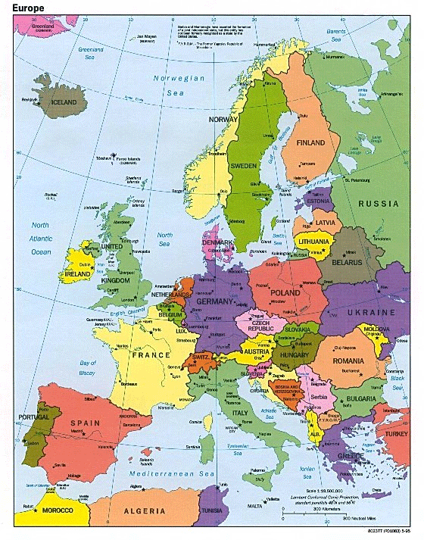
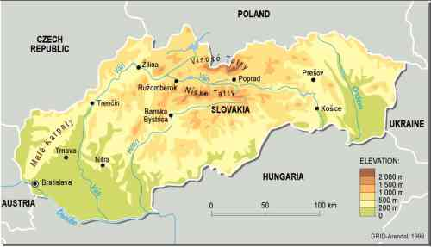
Slovakia

Slide 3
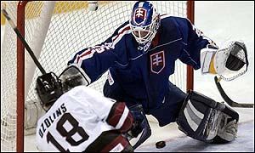
Slovakia
Ice Hockey World Champion 2002
(silver 2001, bronze 2003)
Runner up at 2010 Winter OG in Vancouver

Slide 4

Bratislava

Slide 5
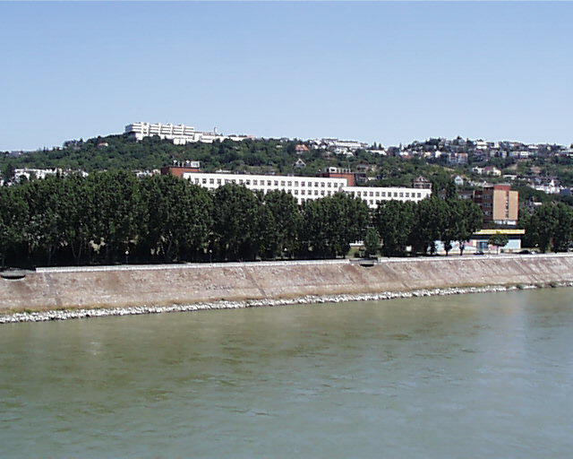
Faculty of Physical Education and Sport
Comenius University
Dept. of Sports Medicine

Slide 6
Functional Evaluation of Ice Hockey Players
Dusan Hamar
Faculty of Physical Education and Sport
Comenius University
Bratislava, Slovakia

Slide 7
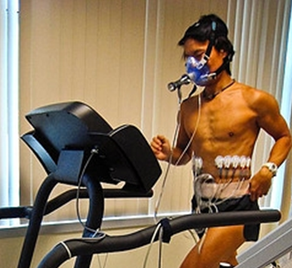
Traditional Approach
Estimation of VO2max

Slide 8
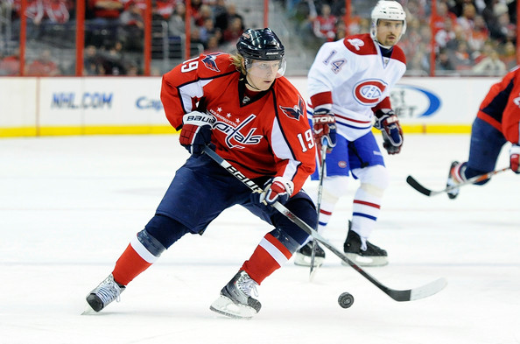
Ice Hockey
Not typical endurance sport

Slide 9
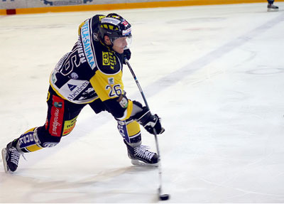
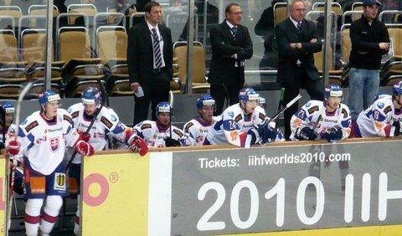
Physiology of Modern Ice Hockey
High intensity exercise bouts lasting 30 to 40 seconds followed by 90 to 120 seconds of rest

Slide 10
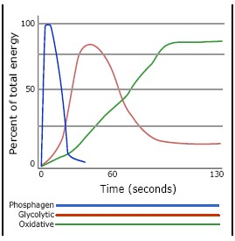
Ice Hockey Performance
Depends mainly on anaerobic energy
  ATP, CP
  Anaerobic glycolysis

Slide 11
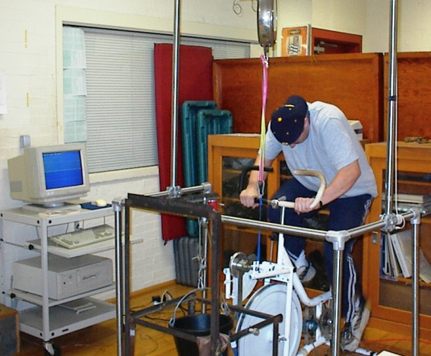
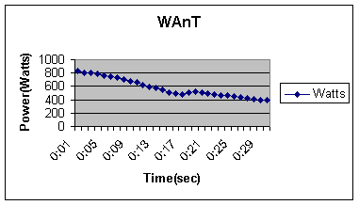
Wingate Anaerobic Test

Slide 12
Parameters of Wingate Anaerobic Test
Pmax
Pmean
Pmax - Pmin
Fatigue index = -----------------
Pmax
Pmin

Slide 13
An Example of Wingate Test Results
MAX POWER - 799 W or 9.5 W/kg
MIN POWER - 408 W or 4.9 W/kg
MEAN POWER - 575 W or 6.8 W/kg
FATIGUE INDEX - 48.9%
TOTAL WORK: 17,264 J or 205 J/kg

Slide 14
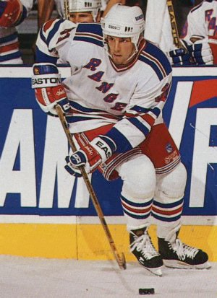
Wingate Test Parameters
Hockey players (n = 600, age 16 – 36 y)
  Mean power
    Average: 991 W (11.6 W/kg)
    Best: 1362 W (resp. 16.0 W/kg)
  Maximal power
    Average: 1255 W (14.7 W/kg)
    Best 1863 W (20.4 W/kg)
  Fatigue index
    Average: 44.5 %
    Best: 35.1 %

Slide 15
An “All-out” Exercise on the Cycle Ergometer
For ice hockey cycling is not a specific form of exercise

Slide 16
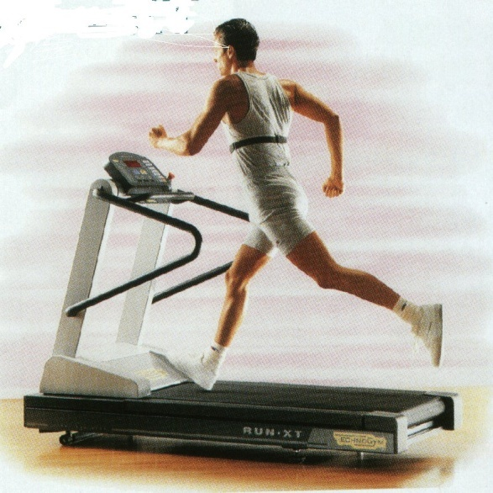
Constant Power “All-Out” Exercise
RUNNING at 22 km/h, 7.5 % slope
Time to
exhaustion:
65.1 s

Slide 17
Tethered Running On The Treadmill

Slide 18
Tethered Running On The Treadmill
In addition to mechanical power requirements of running itself, also power resulting from drag force exerted at given velocity is produced.
P_{D} = F_{D} . v
FORCE
(F)
VELOCITY
(v)

Slide 19
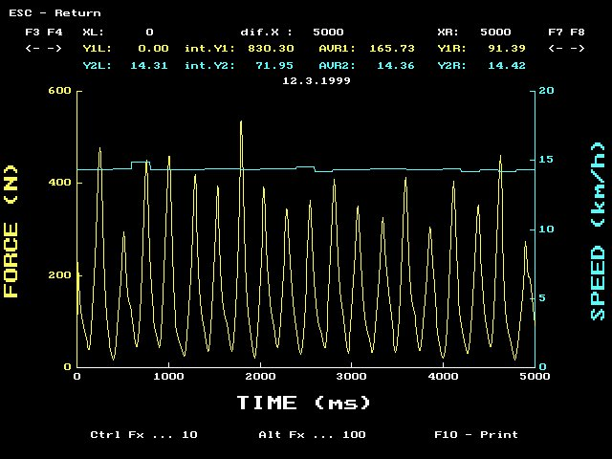

Slide 20
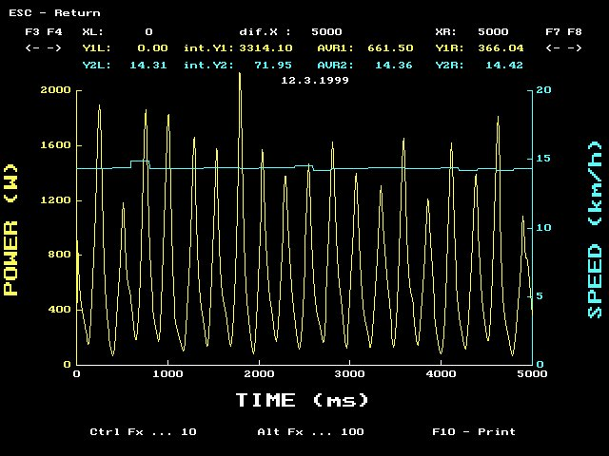

Slide 21
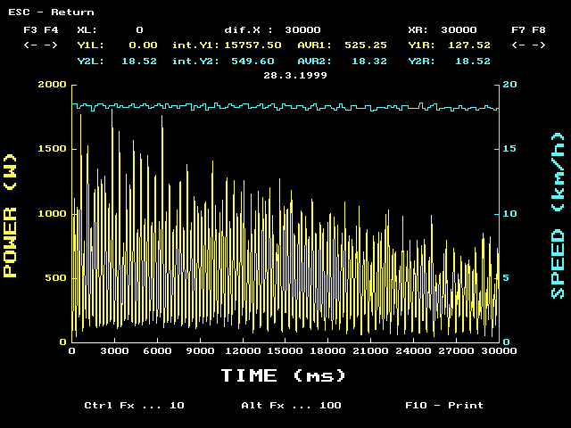

Slide 22
30-s “All-Out” Tethered Running at 18 km/h - Averaged Data Over 5-s Periods

Slide 23
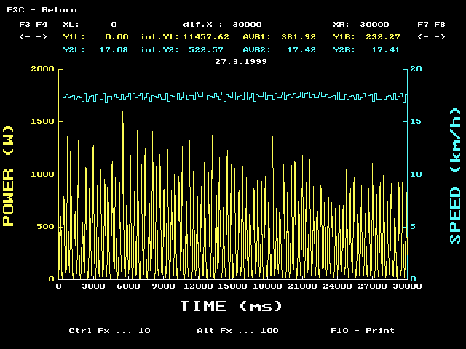
A
B
Pmax: 636 W
Pmean: 525 W
FI: 40 %
Pmax: 409 W
Pmean: 381 W
FI: 15 %

Slide 24
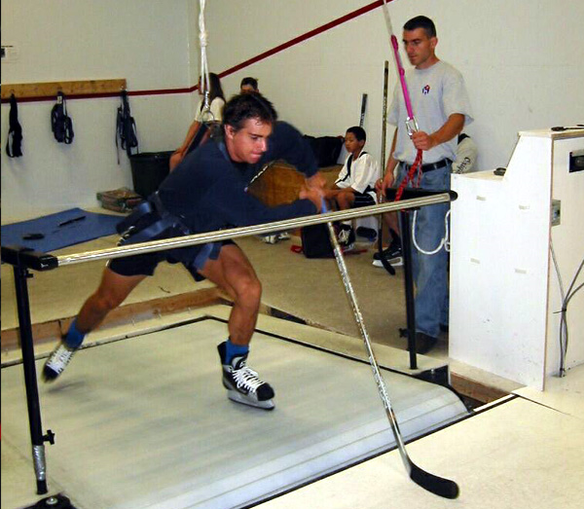
Skatemill

Slide 25
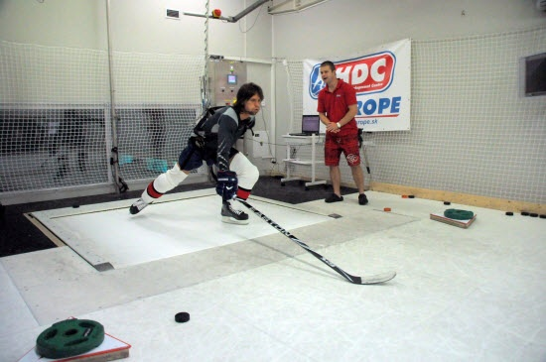
Power Stride

Slide 26
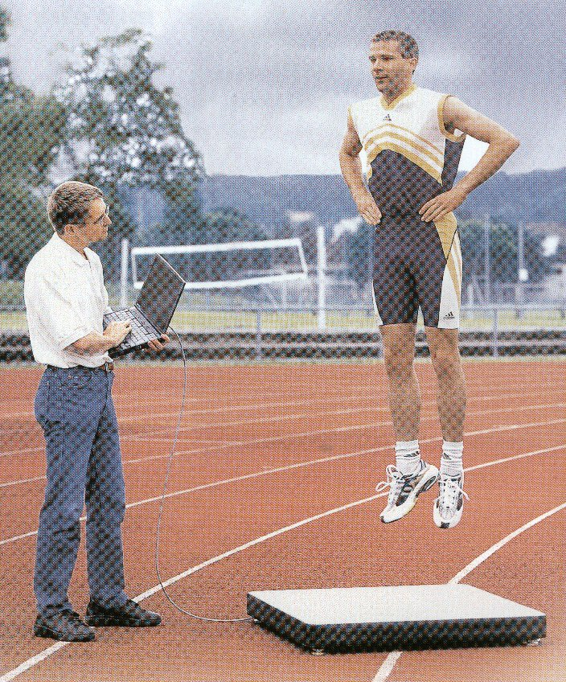
Assessment of Explosive Power of Lower
Force platform

Slide 27
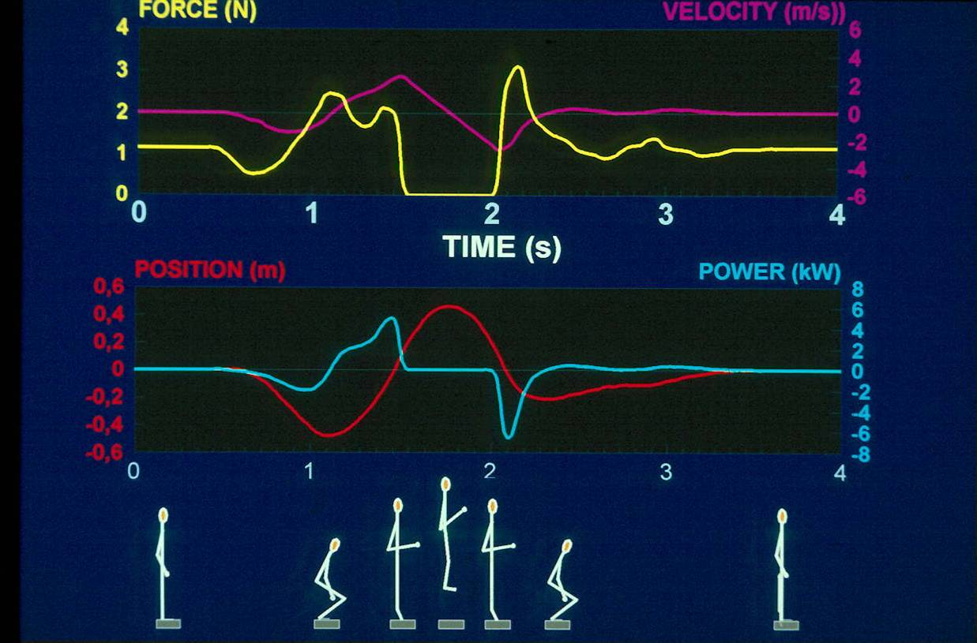
Maximal power: 5067 W, resp. 50,2 W/kg
Height of the jump: 54 cm

Slide 28
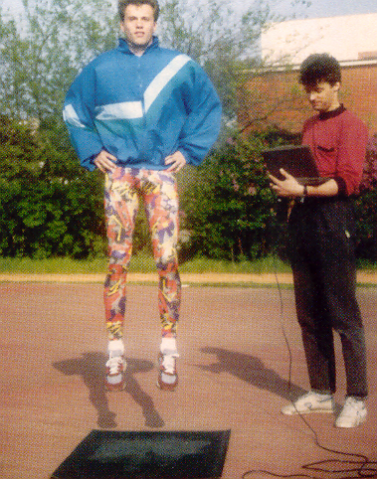
Assessment of Explosive Power of Lower Extremities
Contact platform

Slide 29
Principles of Parameter Estimation on Contact Platform
Measurement of flight and contact times during serial jumps
Calculation of
  Height of the jump
  Power in concentric phase of take off

Slide 30
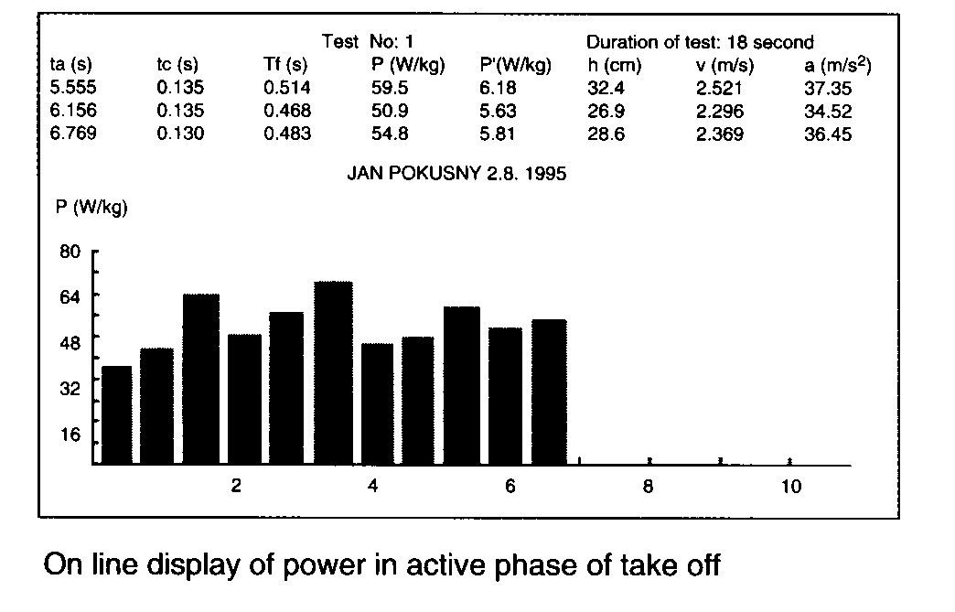
On-line Screen During Measurement

Slide 31
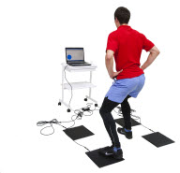
Assessment of Agility

Slide 32
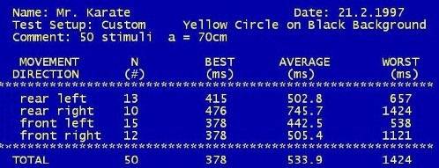
Example of results

Slide 33

„Hockey Goalie“ Simulator

Slide 34
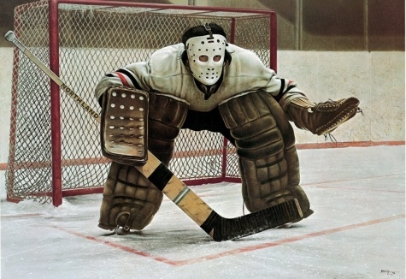
Individual results

Slide 35
Different subjects

Slide 36
Training Effect

Slide 37
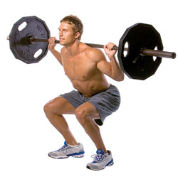
Assessment of Strength

Slide 38
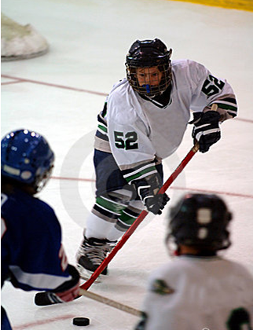
In Ice Hockey Strength Has To be Applied
At relatively high velocity

Slide 39
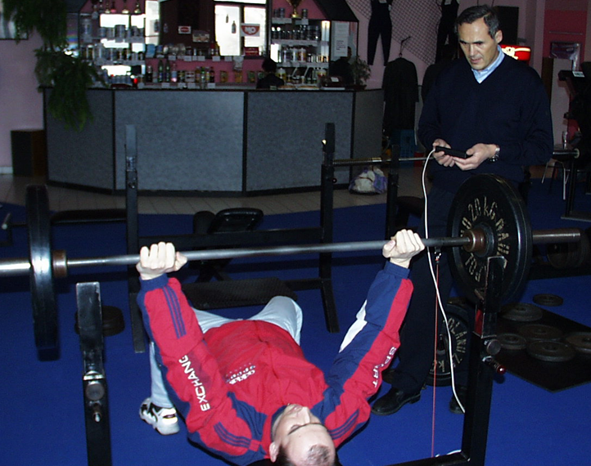
Monitoring of Strength Parameter
Mean force
Power and velocity from concentric phase

Slide 40
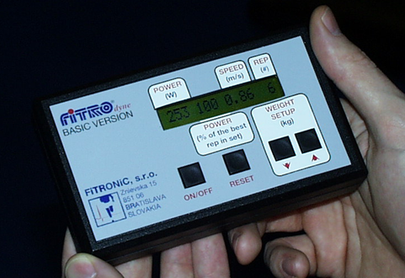
FiTROdyne – a system for monitoring of strength parameters

Slide 41
Pmaxmax

Slide 42
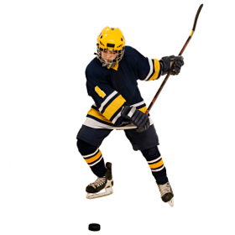
In ice hockey strength has to be applied
At relatively high velocity
In rather short period of time – hockey shot takes less than 200 ms

Slide 43
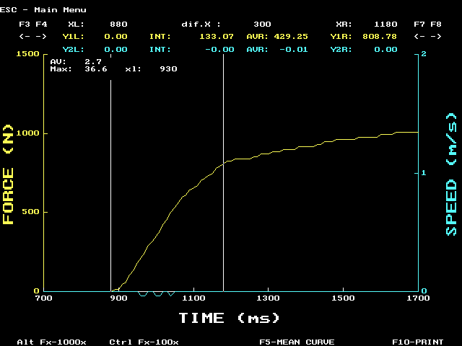
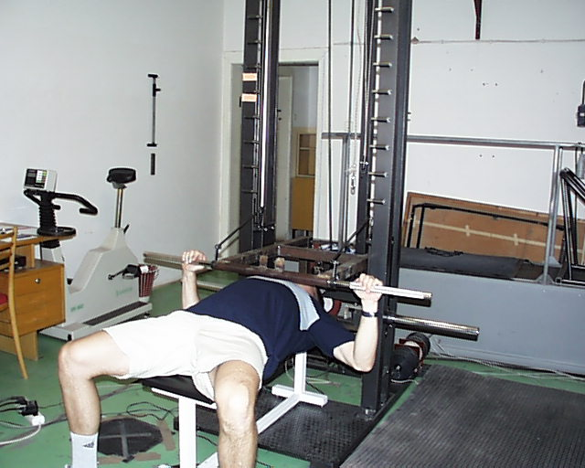
Force Gradient (Rate of the Force Development)

Slide 44
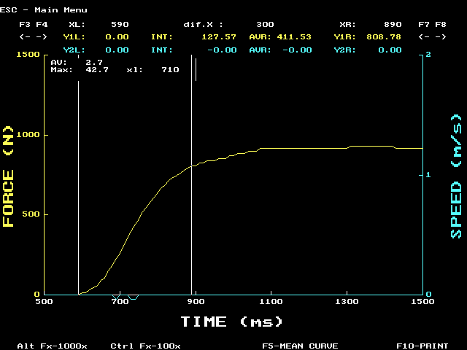
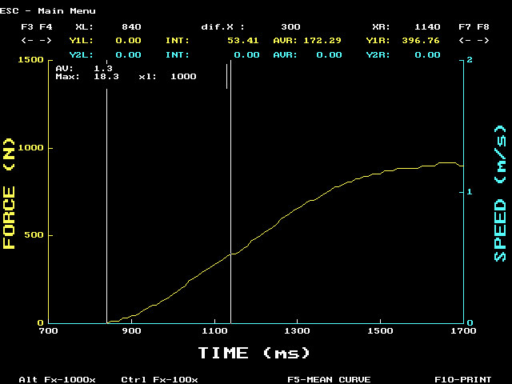

Slide 45
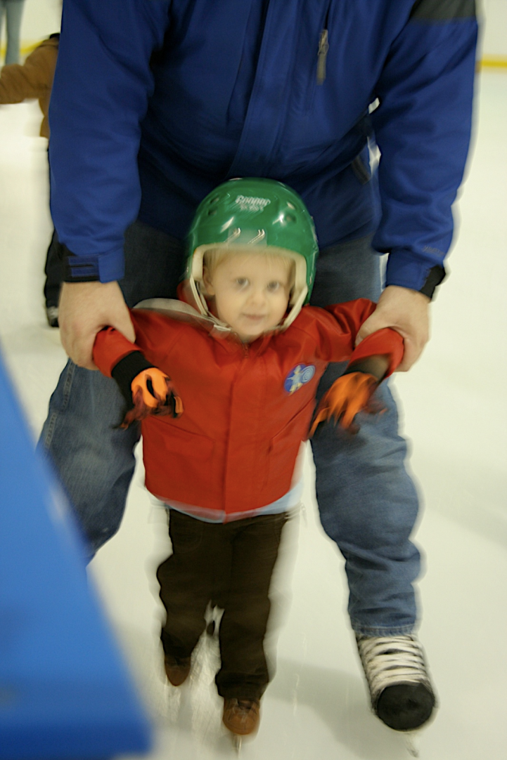
Assessment of Balance and Proprioception

Slide 46
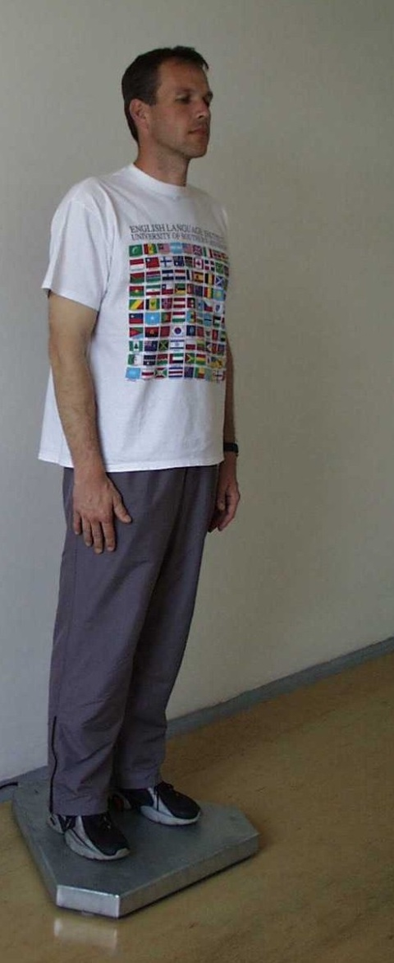
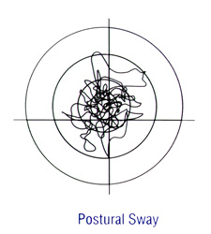
FiTRO Sway check

Slide 47
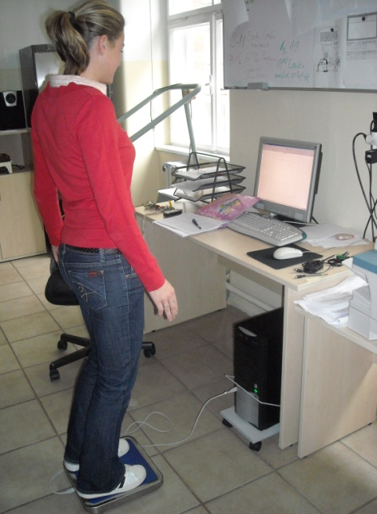
„Driving“ COP Along the Randomly Generated Line
Parameter: Mean distance of actual COP from the flowing curve.

Slide 48
Assessment of Functional Capabilities in Ice Hockey
Enables objective evaluation of training effects
Creates the basis for more specific traning focused on „week links“of physical performance capacity
Enhances training efficiency and success of the team

Slide 49
