Slide 1
Test Item Quality
Dr. Majed Wadi
MBChB, MSc Med Edu

Slide 2
Objectives
To know basic concepts in test item analysis
To know test item analysis criteria for good MCQ
To judge MCQ based on test item analysis

Slide 3
Good Exam
Blueprinting
Good question writing and checking
Standard setting
BUT
Also post hoc item analysis
Make this exam better by excluding bad items
Make later exams better by revising or rejecting questions
(Revest, 2012)

Slide 4
Basic concepts in Test Item Analysis
Exam score is a number which reflects the sum (count) of the correct; raw ratings (Downing, 2009)
Raw
Percentage (%)
Difficulty index is the proportion of examinees who answered an item correctly. It is denoted by p-value (Ebel and Frisbie, 1991; Osterlind, 2002; Downing, 2009; Rahim, 2010).
Sometime, it is called facility index

Slide 5
Basic concepts in Test Item Analysis
Discrimination index (D) is the ability of an item to discriminate between high-ability examinees from low-ability examinees.
It is calculated by getting the difference between the number of examinees getting the correct response in the high-ability and low-ability groups divided by the percentage that is used to identify the high and low examinee.
This percentage can be 25, 27, or 33. (Ebel and Frisbie, 1991; Osterlind, 2002; Downing, 2009a; Rahim, 2010).

Slide 6
Basic concepts in Test Item Analysis
Point-Biserial Correlation is a special type of correlation coefficient (r_{pbis}), in which students’ performance of the item (1 for correct response and 0 for incorrect response) is correlated with their performance of the entire test.
It is used as another variant of the discrimination index. (Osterlind, 2002; Downing, 2009)
It can be calculated using SPSS

Slide 7
Example

Slide 8
Item analysis interpretation
Difficulty index:
Range from 0% or 0 (difficult) to 100% or 1 (easy)
 | Acceptable | Too easy | Too difficulty
Difficulty index | 0.20 – 0.80 | Above 0.80 | Below 0.20
Explanation | Good | Common sense | •Wrong key •Ambiguous/misleading •Trivial fact

Slide 9
Item analysis interpretation
Discrimination index
Range from 1 to -1
Discrimination index | 0.40 and above | 0.20 – 0.39 | Below 0.20 | Negative value
Explanation | Very good item | Reasonably good but need improvement | •Too easy Too difficult •Ambiguous | •Misleading •Wrong answer key

Slide 10
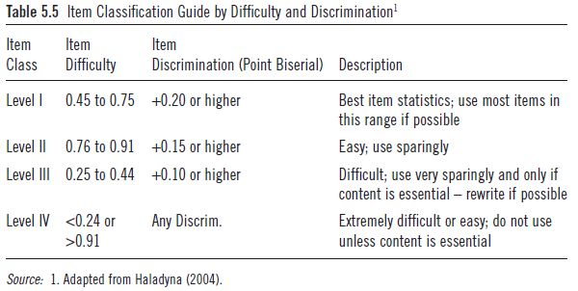
Classification of test item

Slide 11
Thank you

