Slide 1
Vetting of written assessment 1 Theoretical point
Dr. Majed Wadi
MBChB, MSc Med Edu

Slide 2
Objectives
To discuss the concept of vetting process
To describe the findings of literature review regarding this process
To discuss the importance of such process

Slide 3
Vetting of assessment tools
It is the process of reviewing and evaluating question items according to specified criteria with the intention to detect flaws and to edit them accordingly to improve their quality
Vetting process = test item review

Slide 4
Assessment vetting
“Assessment of the questions is as important as assessment of the candidate” (Anderson, 1982)
“If item writing is considered an art, then item editing is a craft” (Baranowski, 2006)

Slide 5
Theoretical model of vetting process
Test item review
⬆ Validity and reliability of test
(Downing and Haladyna, 2004)
⬆ Quality of test
(Wallach et al, 2006)
Accreditation
(WFME, 2012)

Slide 6
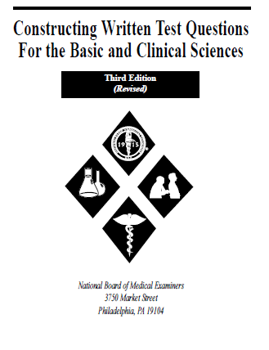
Vetting in literature
1971
Hubbard “Measuring Medical Education”. 1st ed.: Philadelphia: Lea and Febiger.
1998
Case, S. & Swanson, D. “Constructing Written Test Questions for Basic and Clinical Sciences”. Philadelphia National Board of Medical Examiners. Available at: www.nbme.org
1999
Verhoeven et. al “Quality Assurance in Test construction” Education for Health: 12(1):49.

Slide 7
Vetting in literature cont’
2002
Haladyna, T. M., Downing, S. M. & Rodriguez, M. C. A Review of Multiple-Choice Item-Writing Guidelines for Classroom Assessment. Applied Measurement in Education, 15(3), 309 - 333.
The 31 revised taxonomy (31 MCQ’s item writing principles) were come up.

Slide 8
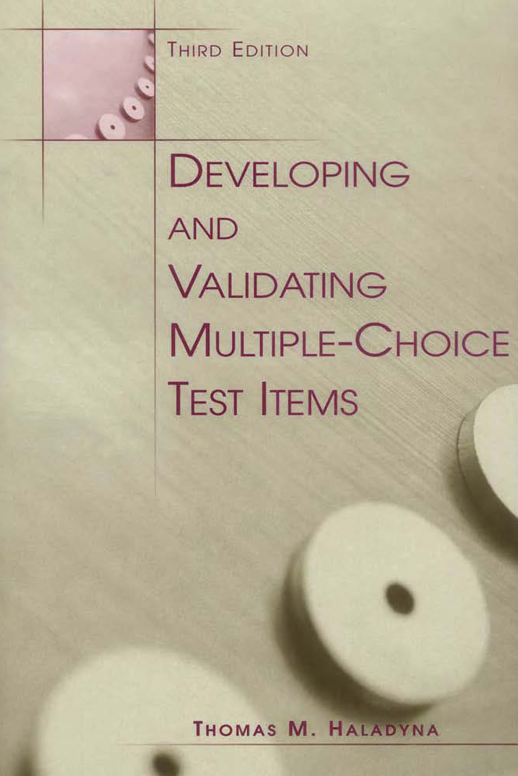
Vetting in literature cont’
2004
Haladyna, T. M. (2004). Developing and validating multiple-choice test items. 3rd ed.: Lawrence Erlbaum.
The roles of test committee were elaborated;
Item-writing principles review (the 31 revised taxonomy)
Cognitive demand review
Content review (test blueprint)
Editorial review (language errors)
Sensitivity and fairness review
Answer key review
Answer justification

Slide 9
Vetting process practicability
MCQs must be adhere to 31 item writing principles as a source of content-related validity (Downing, 2003; Haladyna, 2004)
Violation of such taxonomy is a threat of validity (Downing and Haladyna, 2004) and has a negative impact on examination performance (Downing, 2002; Downing, 2005)
The 31 principles can be conveniently and effectively used as test item review standards. (Haladyna, 2004)

Slide 10
How do we can vet MCQ?
Vetting committee (Departmental and central)
Training
Standardizing vetting (checklist)

Slide 11
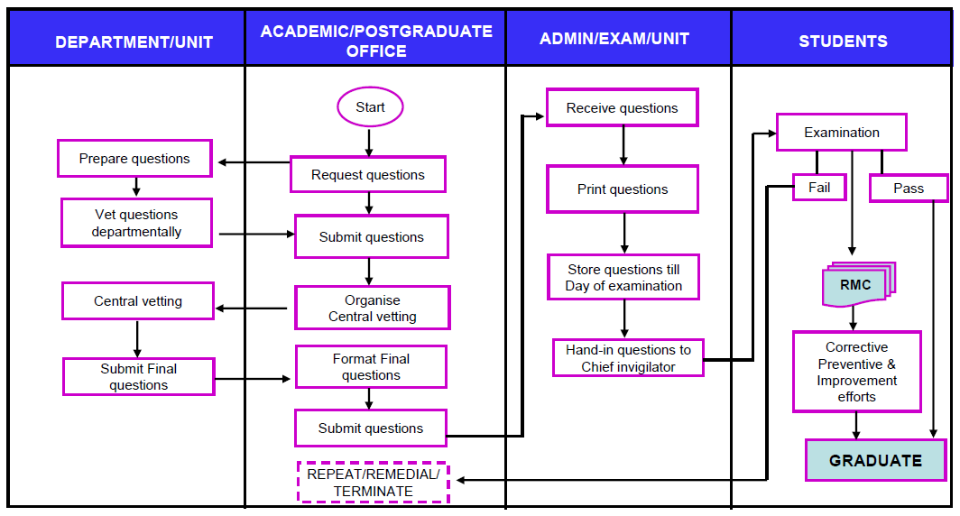
Quality assurance of assessment in School of Medical Sciences, USM

Slide 12
Vetting checklist
The 31 revised taxonomy (31 MCQ’s item writing principles)
(Haladyna et. al., 2002)
MCQ checklist
(Amin et. al., 2006)

Slide 13
MCQ Vetting Checklist
Overall
The topic is important for the learners
The level of difficulty is appropriate
Stem
Stem is clear and complete
Contains no jargon or abbreviations
Context-based/contains integrated clinical vignette
Tests beyond knowledge recall and memorization

Slide 14
MCQ Vetting Checklist cont’
Lead-in
Focuses on one aspect (e.g. indication, side-effects,
contraindication, mechanism of action)
Can be answered without looking at the options
Options
All options are uniform (length, grammatical construct)
Options do not give clue to the answer
No usage of ambiguous terms (e.g. almost, never, frequent)
There is no "all of the above" or "none of the above" option.

Slide 15
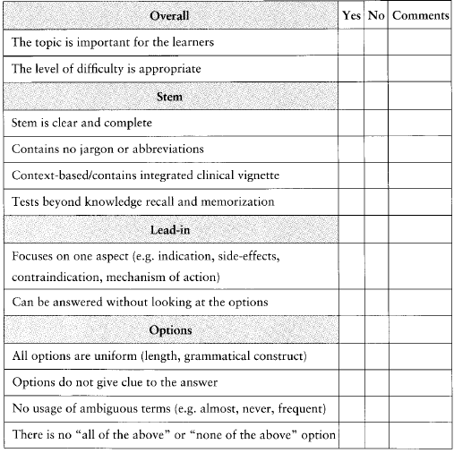
Checklist for MCQ vetting

Slide 16
Thank You

