Slide 1
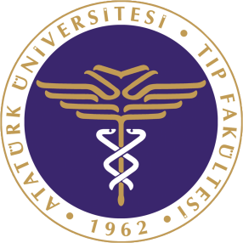
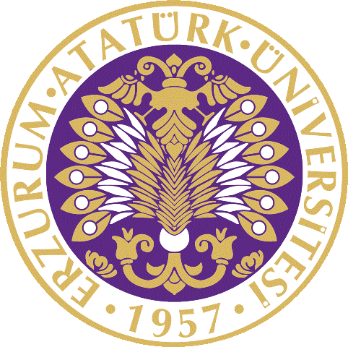
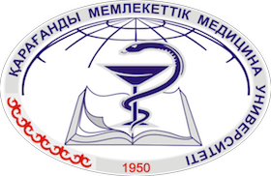
Turkish and English Medium
Medical Education:
Experiences from Atatürk University
The 2nd Central Asian Medical Education Conference
Karaganda, 10-11 October, 2013
Prof. Hikmet Koçak, President, Atatürk University
http://www.atauni.edu.tr

Slide 2
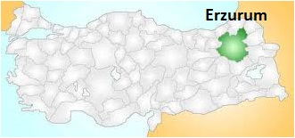
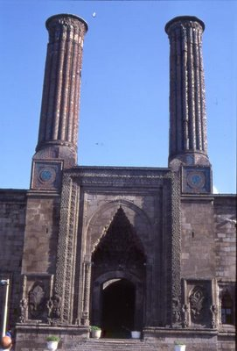
Atatürk University (1957)
Established with collaboration of Nebraska University in Erzurum
Located in North-Eastern Anatolia, Erzurum is a city on the silk road with a history going back to 3000 BC
The city continues to be a center for trade, education, culture, and winter sports.
Of special importance is the Double- Minarett Madrasah with 6 faculties, established in 1290.

Slide 3
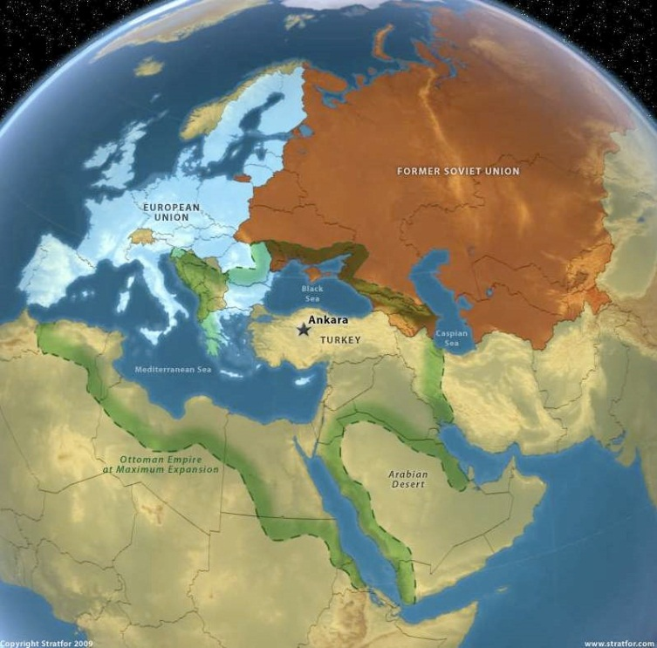
Atatürk University
20 Faculties,
Among them: Medicine, Dentistry, Pharmacy, Nursing, Veterinary Sciences
2 Colleges (4-year)
12 Vocational schools (2-year),
7 Institutes,
1 Conservatory
22 Research centers,
2550 Academic members,
4000 Administrative personnel,
59000 Formal, 35000 distant learning, 1500 international students

Slide 4
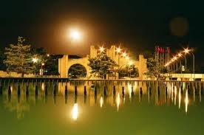
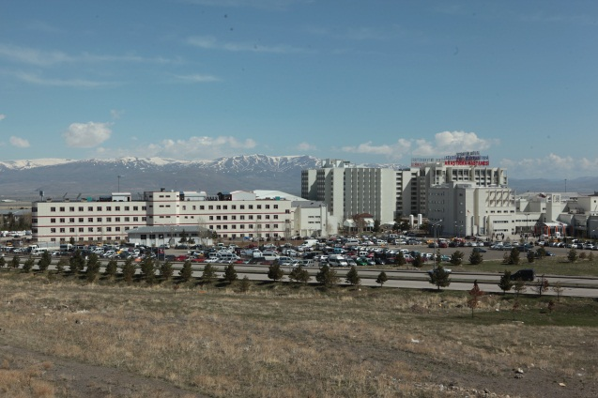
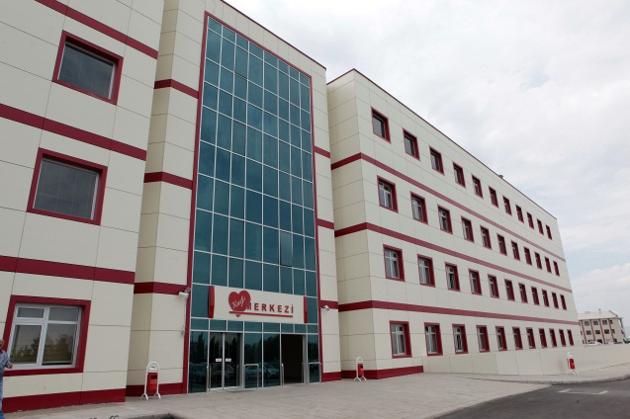
Medical Faculty
Staff:
226 professors
305 resident trainees
545 nurses
Students
Turkish section: 1537
English section: 183
International students: 65

Slide 5
Turkish section was founded in 1962 English section was founded in 2008
English Section
2009
Prep. Class
n=40
Class 2
n=44
Turkish Section
1962
Class 1
n=274
Class 2
n=259
Class 3
n=247
Class 4
n=245
Class 5
n=246
Class 6
n=266
Class 3
n=36
Class 4
n=28
Class 1
n=35

Slide 6
We have international students from the following countries:
Azerbaijan
Cameroon
Caribbean
China
Germany
Iran
Kyrgyzstan
Palastine
Russia
Syria
Turkmenistan
Uganda
Ukraine
Uzbekistan

Slide 7
Acceptance Procedure
Applications are collected online on August.
Selection criteria for international students:
Turkish Communities Exam (TCS)
Scholarship from home country
Direct application to Atatürk University :
Exam at Atatürk University
High school diploma scores
Country quota

Slide 8
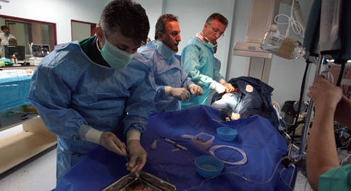
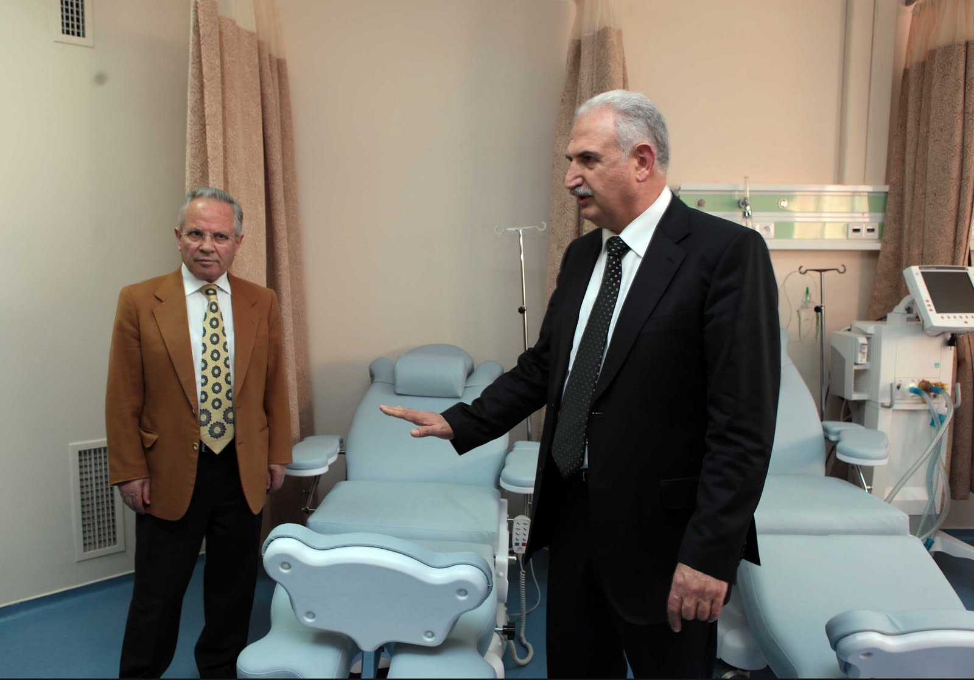
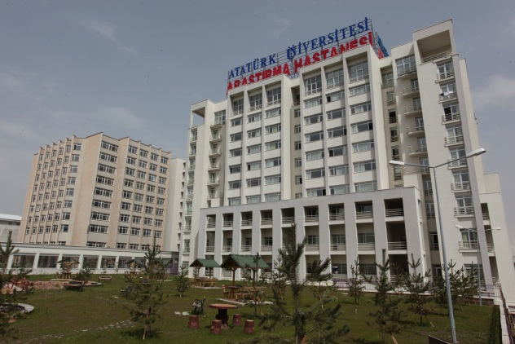
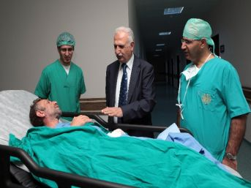
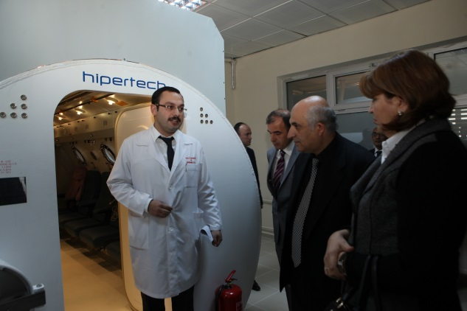
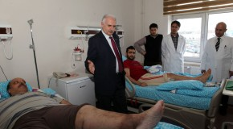
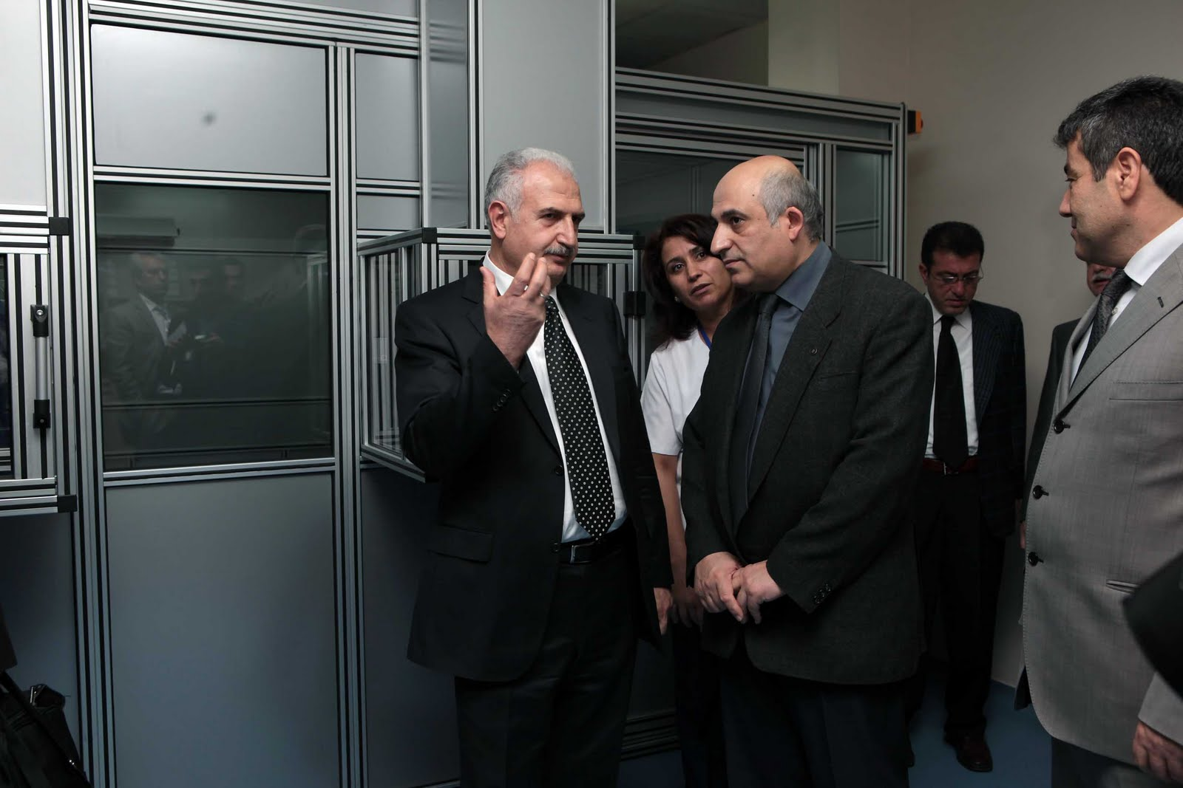
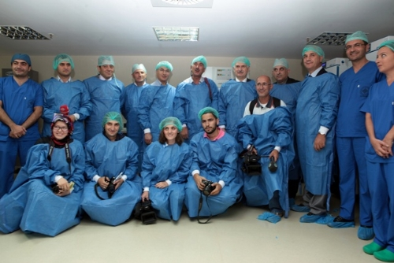
Medical Faculty Research Hospital
1460 bed capacity hospital serving the region and neighbouring countries
Top quality health opportunities:
Modern radiology, Cardiac Center
Chemotherapy, Burn center
IVF, Hyperbaric oxygen therapy
Transplantation unit, Bone marrow transp.
Healthy Lifestyles and Integrative Medicine Center (CAM)
60 000 inpatients/year
35 000 surgical interventions/year
650 000 outpatient visits/year

Slide 9
Academic Staff
Academic Staff
Basic Sciences
Professors
n=17
Internal Sciences
Prof.
n=43
Surgical Sciences
Prof.
n=35
Assoc. Prof.
n=8
Assist. Prof.
n=16
Resident Trainee
n=15
Assoc. Prof.
n=24
Assist. Prof.
n=48
Resident Trainee
n=178
Assoc. Prof
n=12.
Assist. Prof.
n=23
Resident Trainee
n=112

Slide 10
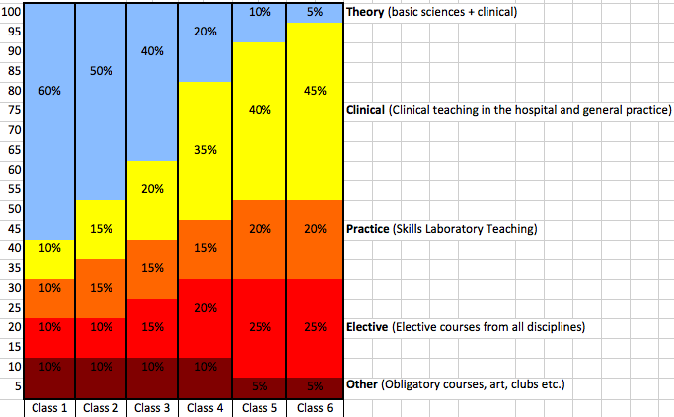
Curriculum Structure

Slide 11
To Be a Part of the Academic Staff
Eurasian Silk Road Universities Consortium (ESRUC)
Turkic Universities Union Program (TUNİB)
Mevlana Exchange Program
Via Turkish Academy of Sciences (TUBITAK)
Visiting Professorship
Permanent staff

Slide 12
ESRUC
Established with the collaboration of almost 200 universities on the silk road from 30 countries intended to carry out joint graduate studies and projects.
Visiting professors coming via ESRUC will be provided accommodation plus a payment of 2000-3000 USD/month.
The presidency of the consortioum is undertaken by Atatürk University
The first three meetings were held in Erzurum. This year the fourth meeting will be in India.
For further information: http://esruc.atauni.edu.tr/

Slide 13
TUNIB
Founded with the collaboration of 15 universities from Azerbaijan, Kazakhstan, Kyrgyzstan, and Turkey under the auspices of the presidents of the countries in Bishkek in May 2013. Intended to promote collaboration between universities in Turkic states.
Atatürk University was elected for the presidency of the union.
The first meeting will be held in Erzurum in May 2014.

Slide 14
Mevlana Exchange Program
Started in 2013-2014 teaching period. The easiest and fastest way to collaborate.
This year we had over 100 exchange of students and staff.
The program supports both incoming and outgoing students as well as staff.
Scholarships are given by the Turkish Council for Higher Education.
We are looking forward to making agreements with rectors of your universities.
See: http://mevlana.atauni.edu.tr/

Slide 15
Turkish Academy of Sciences
Several international support programs are available through TUBITAK for visiting researchers.
International support programs meet both accommodation and living expenses of visiting scholars.
TUBITAK offers a large number of support varieties: http://www.tubitak.gov.tr/en

Slide 16
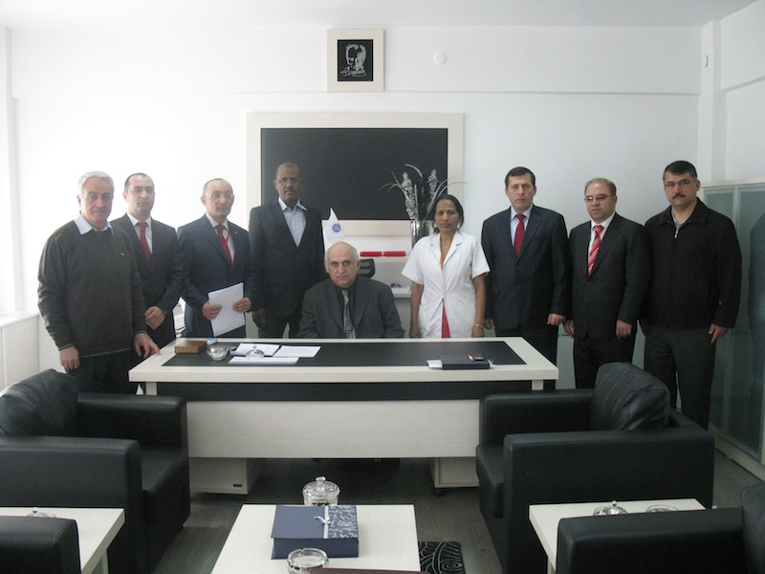
Visiting Professors
We have accepted visiting professors from several countries

Slide 17
Permanent Staff
We appreciate scholars to work with us as permanent staff members.
Applications are done directly to related departments.
The university also provides accommodation in addition to salary.

Slide 18
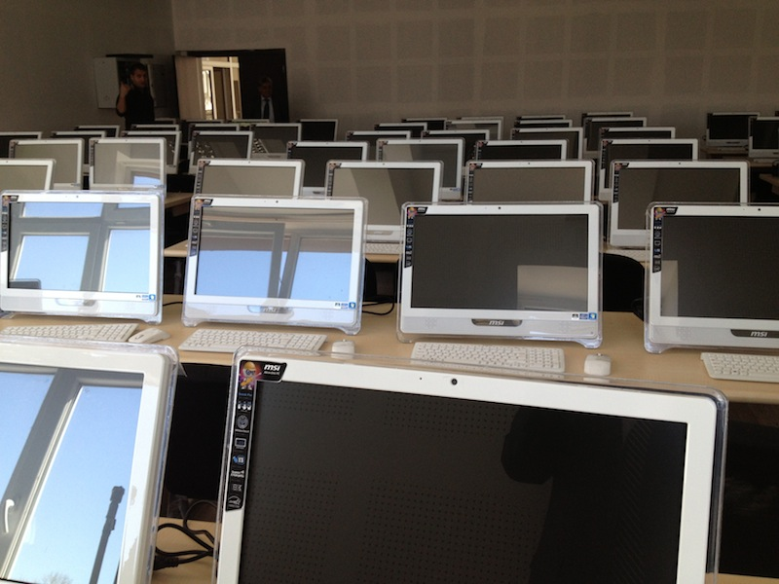
Infrastructure

Slide 19
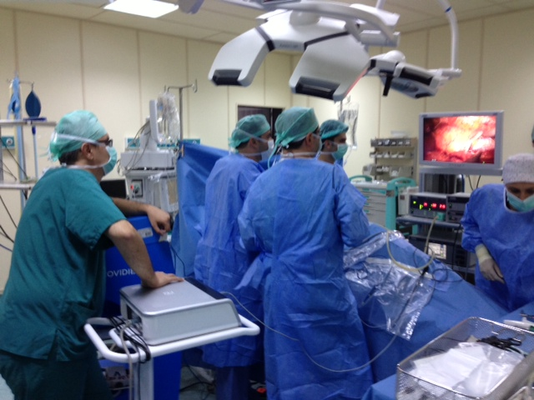

Slide 20
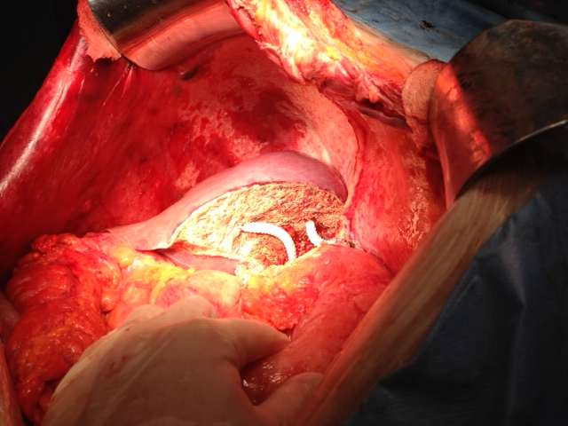

Slide 21
Graduates
Atatürk University is regarded as the university that founds universities.
The same is valid also for faculty of medicine.
There are numerous graduates in the parliament and at high positions such as general directors or rectors of universities.

Slide 22
CONCLUSION
Atatürk University is one of the oldest and biggest universities in Turkey (The fifth of 183 universities).
It is famous as the ‘university establishing universities’.
We have both Turkish and English medium medical faculties.
There are many opportunities to collaborate for joint projects and PhD programs with Faculty of Medicine, Atatürk University.

Slide 23
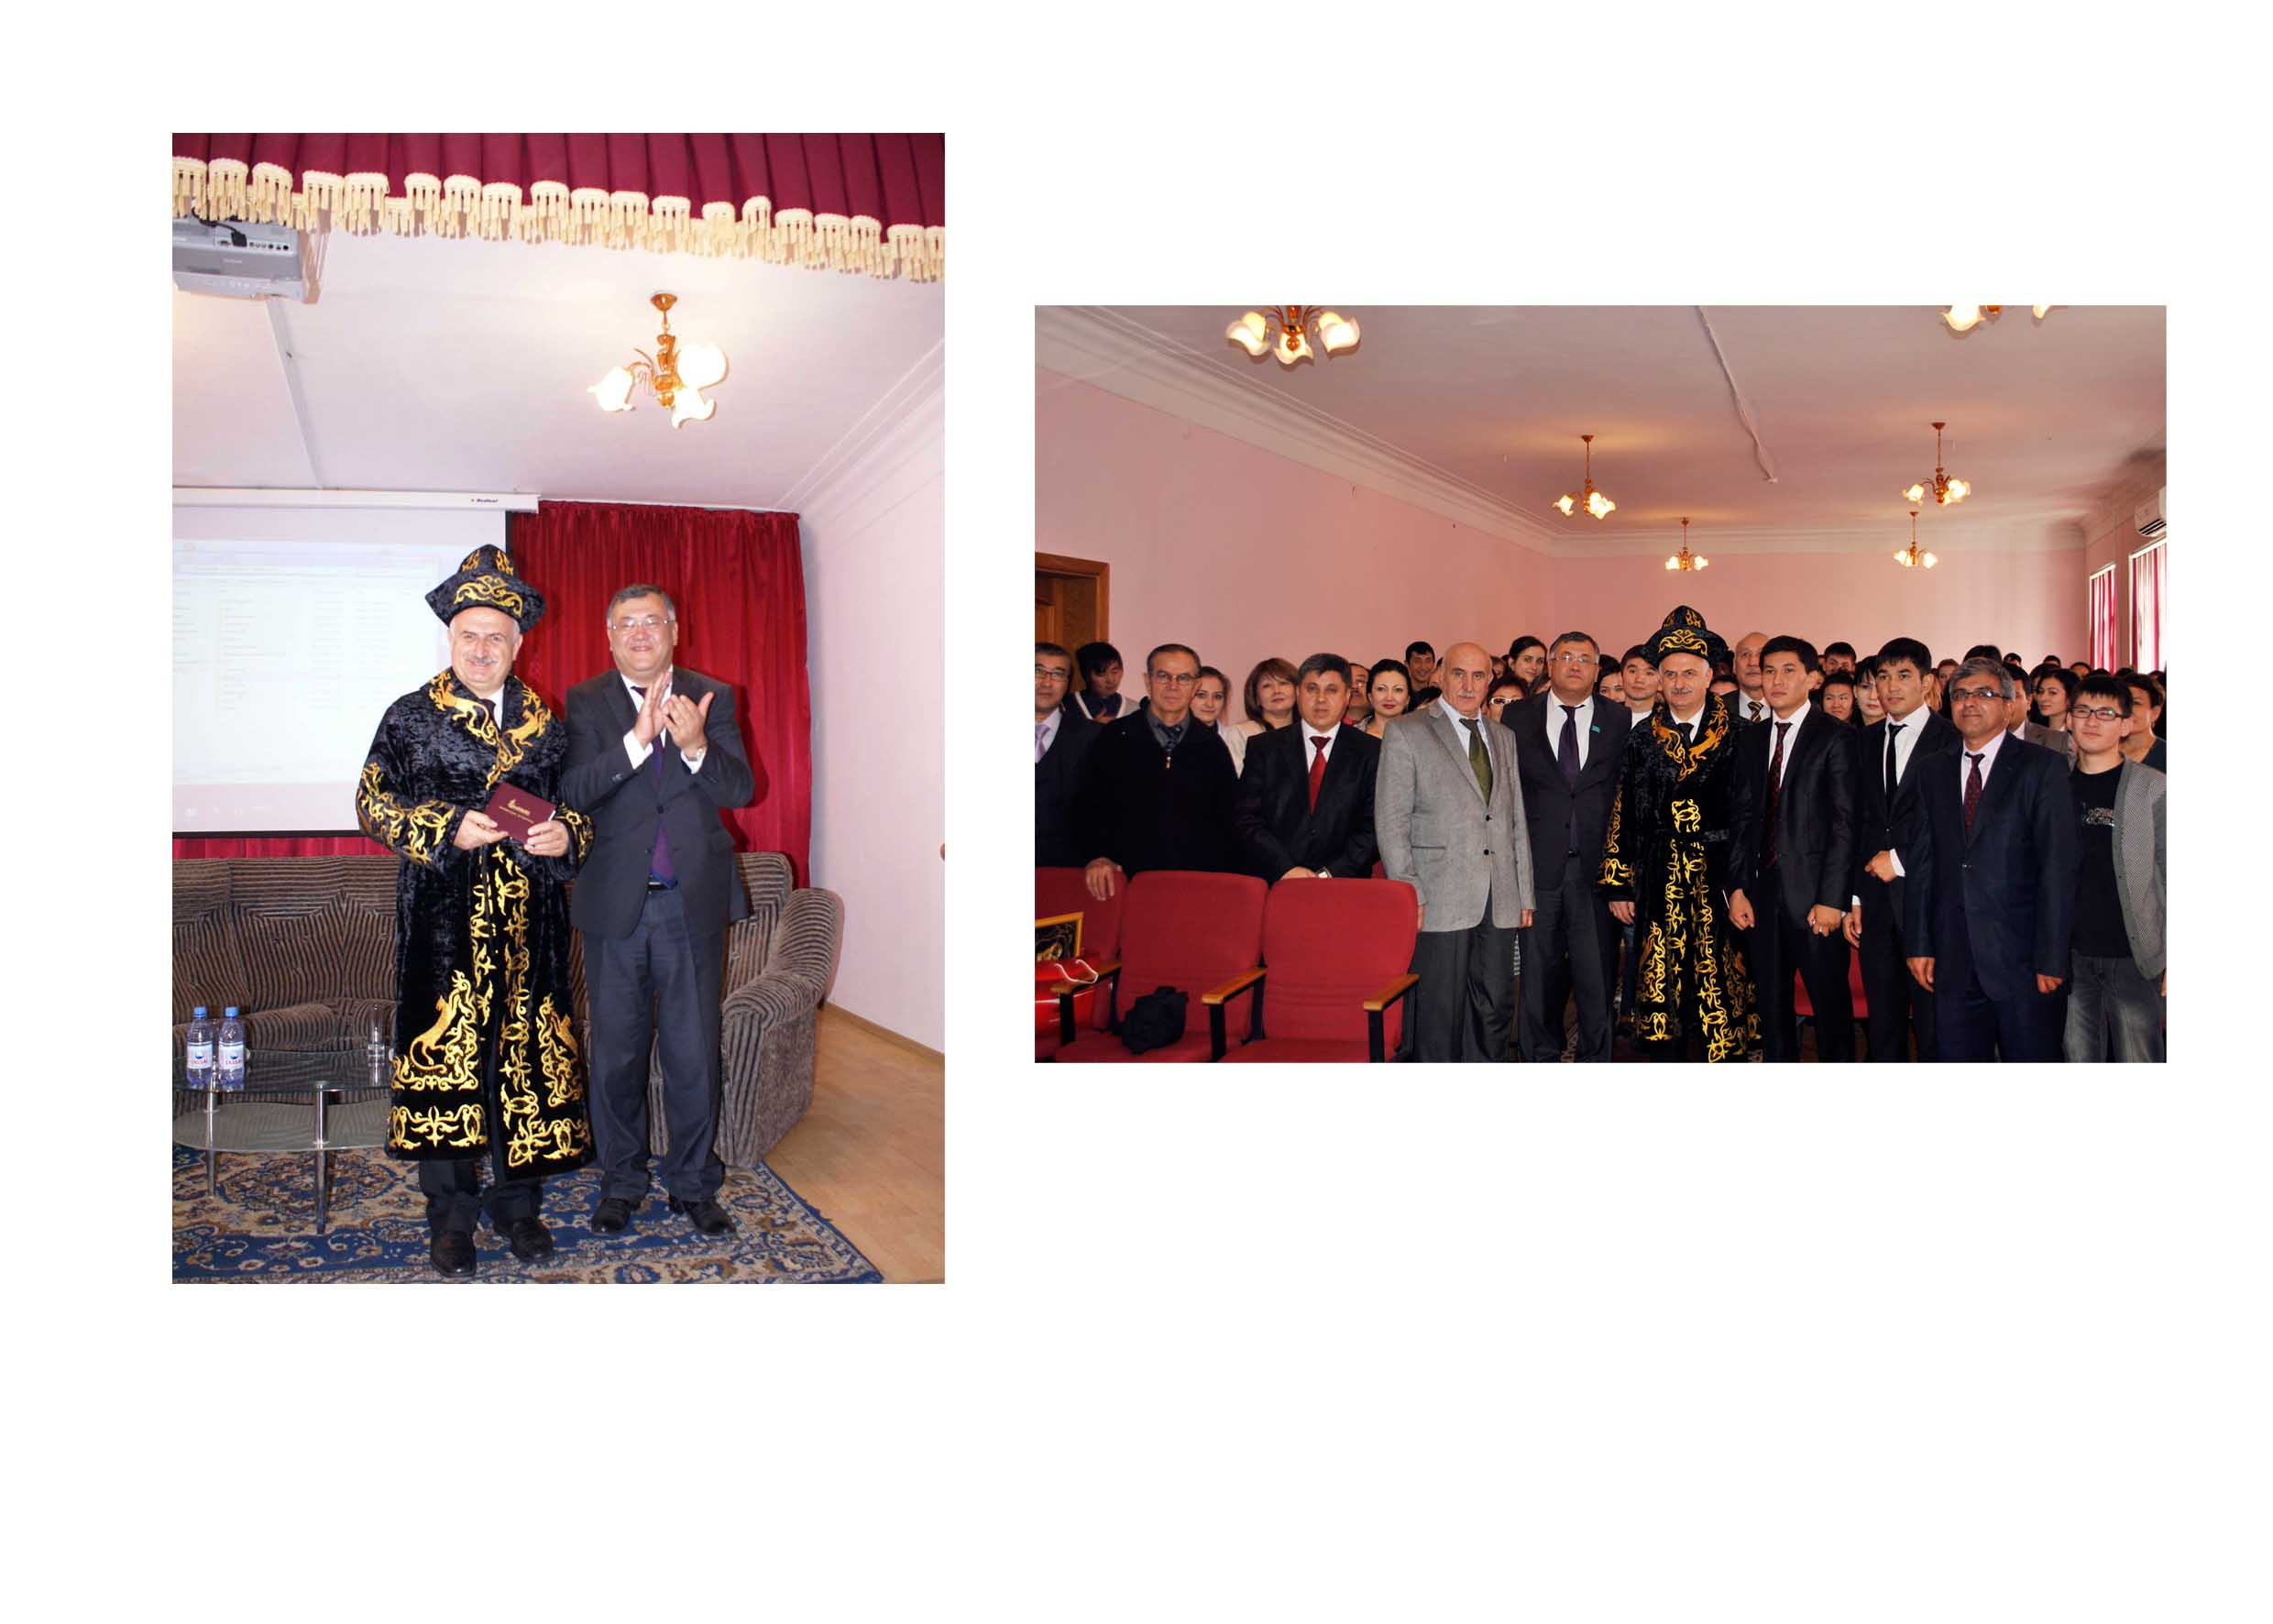
RAHMET!

